Slide 1



AUTONOMOUS CAR (IMAGE & VIDEO PROCESSING)
CHEMENG 788 - Neural Networks and Development Tools
CHEMENG 789 - Deep Learning and Its Application
Somak Mukherjee

Slide 2


OBJECTIVE
Whether we are already living in the “Automation” is a matter of debate, but it won’t be for much longer. The current wave of technologies is transforming the business landscape, with Artificial Intelligence, Machine Learning, Neural Network, Deep Learning, Image processing and Robotics advancements allowing companies to automate an increasing number of routine tasks once performed by humans.

Slide 3
CONTENTS
01
SYSTEM
02
OPEN CV + PYTHON
03
NEURAL NETWORK & DEEP LEARNING
04
CODE ANALYSIS
05
BENEFITS

Slide 4

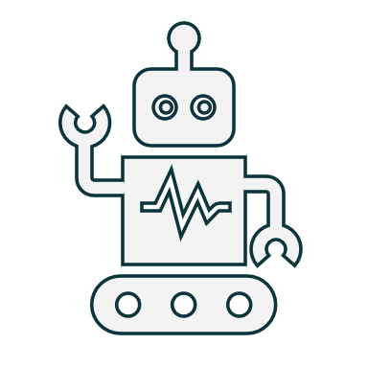

SYSTEM
01
ROBOTICS & RASPBERRY PI

Slide 5
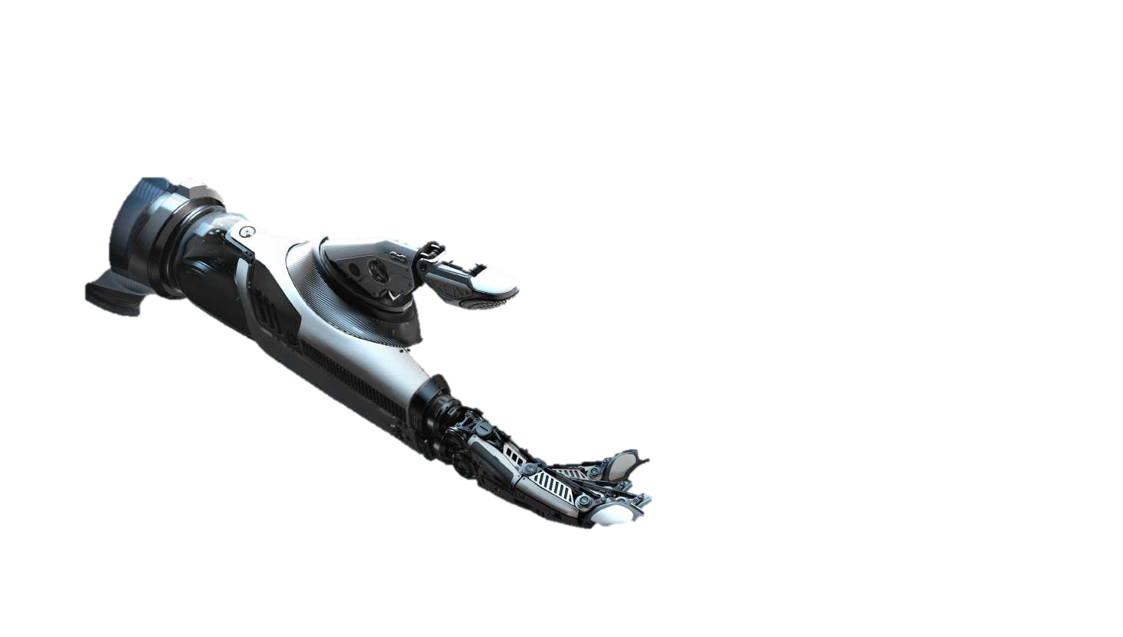
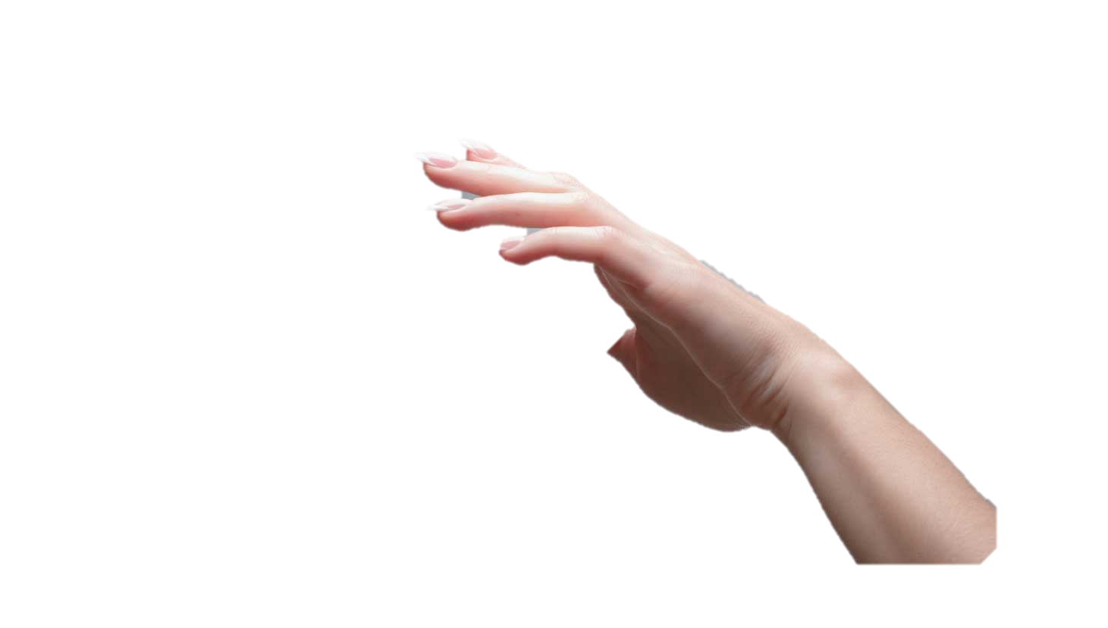
ROBOTICS
Robotics is a scientific and engineering discipline that is focused on the understanding and use of artificial, embodied capabilities.
Robots are machines that can substitute for humans and replicate human actions and are used to do jobs that are difficult, impossible, or just tedious for humans to do.
Robots can be used in many situations and for lots of purposes, but today many are used in dangerous environments (including bomb detection and deactivation), manufacturing processes, or where humans cannot survive (e.g. in space, under water, in high heat, and for clean up and containment of hazardous materials and radiation).

Slide 6
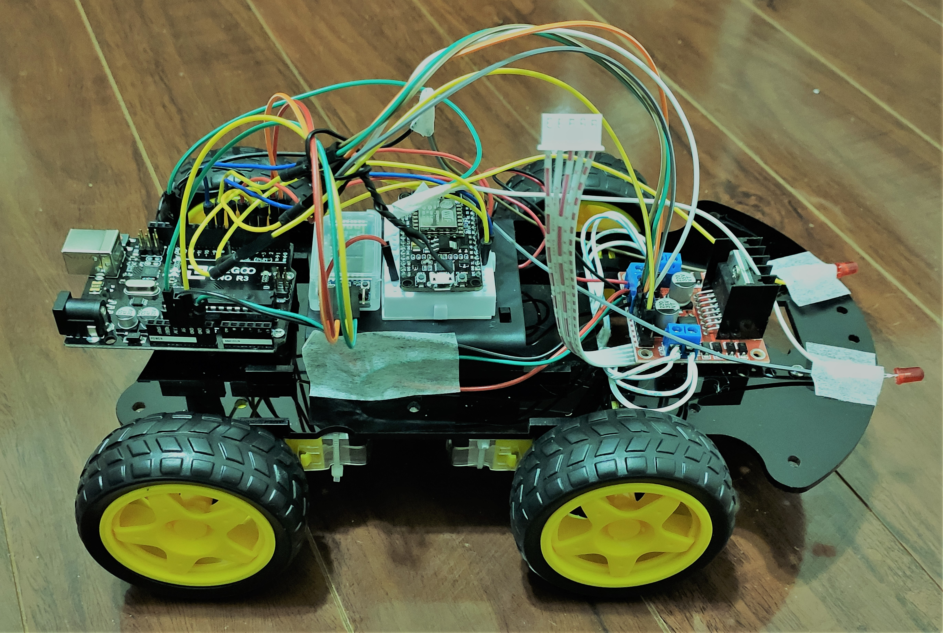
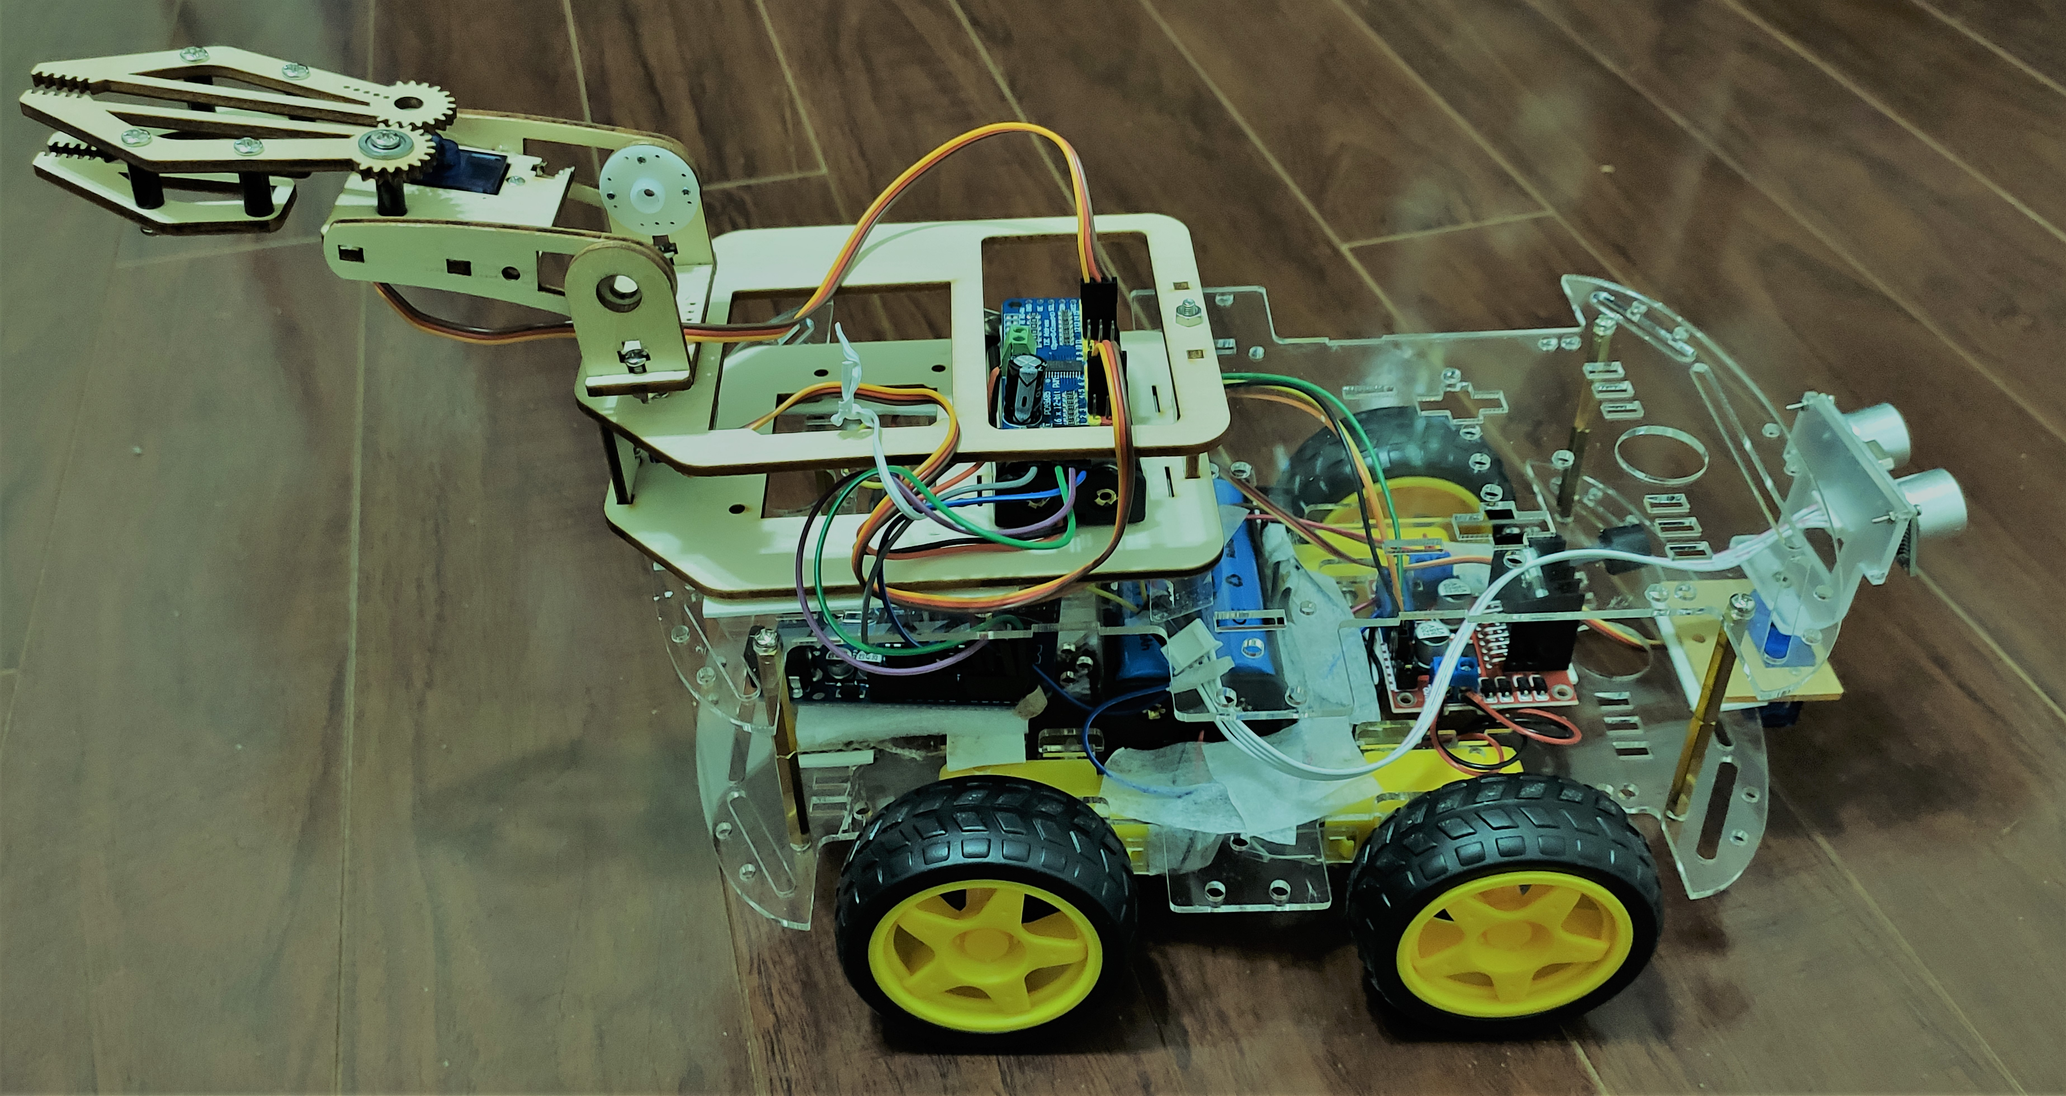
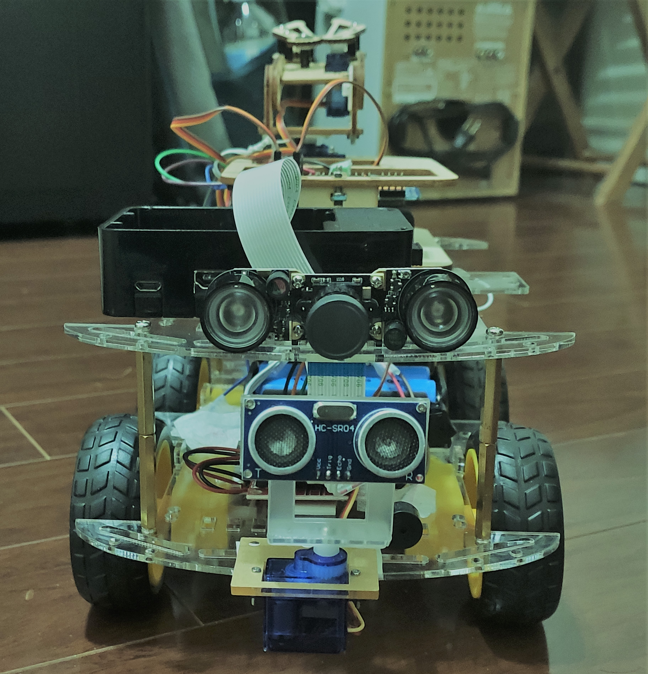
OBSTACLE AVOIDANCE & Wi-Fi & Bluetooth
Open source code circuit design, program development interface free download, can also be modified according to your needs.
Through the infrared obstacle avoidance sensor, it can realize automatic following or obstacle avoidance function.
It can be used as a regional exploration robot and an emergency rescue robot’s motion system, allowing the robot to automatically avoid obstacles while traveling.
The wireless car is controlled via smartphone which is connected to the Bluetooth module and a Wi-Fi module.
Now a days due to advancement in technology various newly designed smart homes make use of Wi-Fi enabled robot for various applications.
Robot car controlled by Wi-Fi will make our work much easier as we can make the robot do any work, we need by just a single movement on our mobile phone on computer.

Slide 7
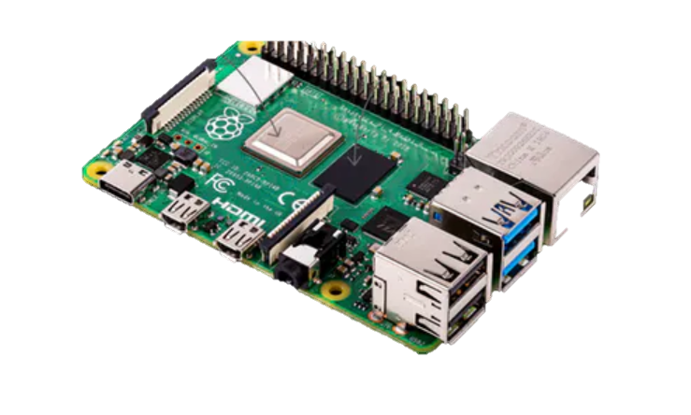
RASPBERRY PI
The Raspberry Pi is a very cheap computer that runs Linux, but it also provides a set of GPIO (general purpose input/output) pins that allow you to control electronic components.
It comes with Pi-Camera module with python interpreter. Pi camera can capture directly to any object which supports Python’s buffer protocol (including NumPy).
There are several developers and applications that are leveraging the Raspberry Pi for automation.

Slide 8
PYTHON & OPENCV
02
OPEN SOURCE COMPUTER VISION

Slide 9
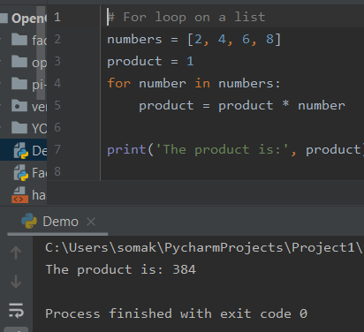
PYTHON CODING
Python is an interpreted, high-level, general-purpose programming language. It supports multiple programming paradigms, including procedural, object-oriented, and functional programming.
Python strives for a simpler, less-cluttered syntax and grammar while giving developers a choice in their coding methodology. Python's design offers some support for functional programming in the Lisp tradition. It has filter, map, and reduce functions; list comprehensions, dictionaries, sets, and generator expressions.
Python programming language can be use in desktop and web applications. Also, you can use Python for developing complex scientific and numeric applications. Python is designed with features to facilitate data analysis and visualization.

Slide 10
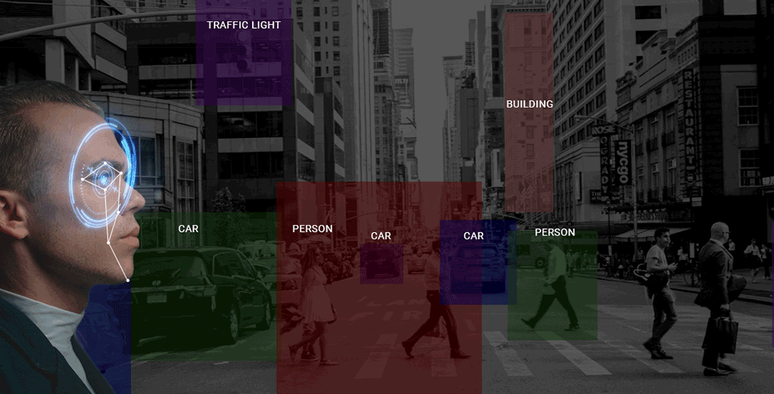
OPEN SOURCE COMPUTER VISION
Computer Vision is a field of deep learning that enables machines to see, identify and process images like humans.
Reading and writing images is essential to any computer vision project. Machines see and process everything using numbers, including images and text. And the OpenCV library makes this function a whole lot easier.
OpenCV (Open Source Computer Vision Library) is an open source computer vision and machine learning software library. It was developed so that real-time analytics of images and recognition can be done for assorted applications.

Slide 11
NEURAL NETWORK & DEEP LEARNING
03
ROBOTICS & RASPBERRY PI

Slide 12
NEURAL NETWORK & DEEP LEARNING
Neural networks are a set of algorithms, that are designed to recognize patterns.
Neural networks are used for solving many business problems such as sales forecasting, customer research, data validation, and risk management.
Deep learning is part of a broader family of machine learning methods based on artificial neural networks.
Deep learning is an artificial intelligence function that imitates the workings of the human brain in processing data and creating patterns for use in decision making.
Very useful for Image & Video Processing.

Slide 13

TENSOR FLOW & TENSOR FLOW LITE
Tensor Flow is an open source artificial intelligence library, using data flow graphs to build models. It allows developers to create large-scale neural networks with many layers. TensorFlow is mainly used for: Classification, Perception, Understanding, Discovering, Prediction and Creation.
TensorFlow gives you the flexibility and control with features like the KERAS Functional API and Model Sub classing API for creation of complex topologies.
TensorFlow Lite is an optimized framework for deploying lightweight deep learning models on resource-constrained edge devices. TensorFlow Lite models have faster inference time and require less processing power, so they can be used to obtain faster performance in real time applications.

Slide 14
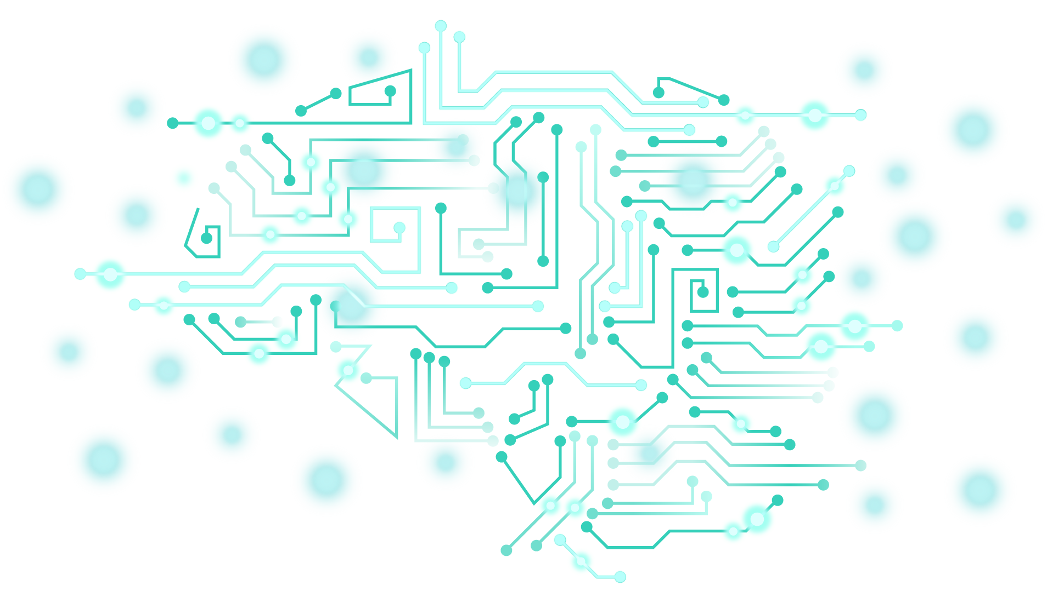
YOLO – Real Time Object Detection
Darknet is an open source neural network framework written in C and CUDA. It is fast, easy to install, and supports CPU and GPU computation.
YOLOv3 is extremely fast and accurate. Moreover, you can easily tradeoff between speed and accuracy simply by changing the size of the model, no retraining required!
They apply the model to an image at multiple locations and scales. High scoring regions of the image are considered detections.
YOLO apply a single neural network to the full image. This network divides the image into regions and predicts bounding boxes and probabilities for each region. These bounding boxes are weighted by the predicted probabilities.

Slide 15
CODE ANALYSIS
04
IMAGE, VIDEO & WEBCAM/CARMERA PROCESSING

Slide 16

DETECTION CONCEPT
A detection model has two files associated with it: a detect.tflite file (which is the model itself) and a labelmap.txt file (which provides a label map for the model).
Google provides a sample quantized SSDLite-MobileNet-v2 object detection model which is trained off the MSCOCO dataset and converted to run on TensorFlow Lite. It can detect and identify 80 different common objects, such as people, cars, cups, etc.
You can also use a custom object detection model by yourself. TensorFlow provides several object detection models (pre-trained classifiers with specific neural network architectures) in its model zoo.
The TensorFlow Object Detection API requires several additional Python packages, specific additions to the PATH and PYTHONPATH variables, and a few extra setup commands to get everything set up to run or train an object detection model.

Slide 17
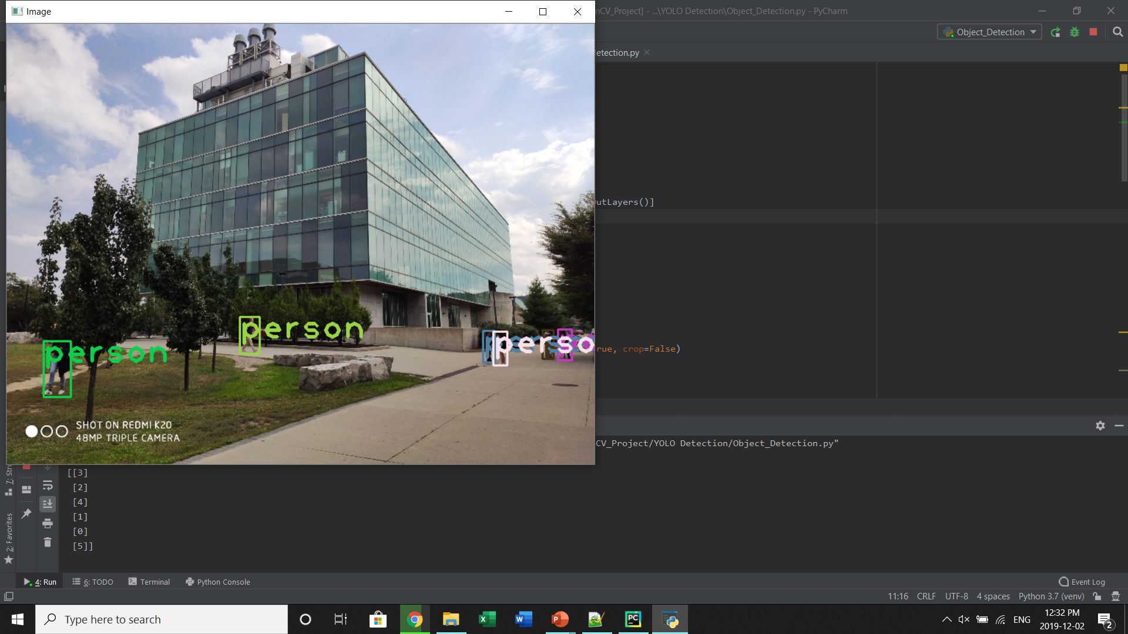
IMAGE PROCESSING
Import the package
Load YOLO Data
Load image
Detecting the object
Showing the information on the screen
import cv2 import numpy as np
net = cv2.dnn.readNet("yolov3.weights", "yolov3.cfg") classes = [] with open("coco.names", "r") as f: classes = [line.strip() for line in f.readlines()]
img = cv2.imread("IMG7.jpg") img = cv2.resize(img, None, fx=0.4, fy=0.4)

Slide 18
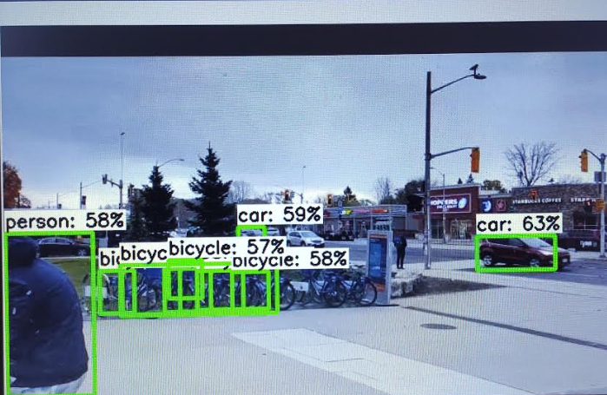
VIDEO PROCESSING
Import the package
Load YOLO Data
Load Video
Detecting the object
Showing the information on the screen
import cv2 import numpy as np
net = cv2.dnn.readNet("yolov3.weights", "yolov3.cfg") classes = [] with open("coco.names", "r") as f: classes = [line.strip() for line in f.readlines()]
cap = cv2.VideoCapture("Video1.mp4") font = cv2.FONT_HERSHEY_PLAIN

Slide 19
BENEFITS
05
SOLUTION

Slide 20
AUTOMATION SOLUTION
Obstacle Avoidance
Wi-Fi & Bluetooth Control
The obstacle avoidance robotics is used for detecting obstacles and avoiding the collision. This is an autonomous robot..
Can be able to control the car with Wi/-fi and Bluetooth from phone.
Robotic Arm with Gripper
Video Processing – Raspberry Pi
The robotic arm is used for multiple industrial applications. Also Can be use in various method such as to create a line, hold some object..
Installed camera can detect the real time traffic signal and can identify the cars, peoples on the road.
Line Follower
Image Processing – Raspberry Pi
Can be use in Industry sector, shopping mall, health car and can be used in long distance..
The car can be used as security vehicle to take pictures and those can be accessible directly from your own computer.
Autonomous Car

Slide 21
AI, Deep Learning and machine learning will have a transformative impact on industrial robots. While these technologies are still in their infancy, they will continue to push the boundaries of what’s possible with industrial robotic automation over the next few decades.

Slide 22
THANK YOU!

